Slide 1
Variant Subsystems
aka “the ol’ switcheroo”

Slide 2
Functionality
“Variant subsystems provide multiple implementations for a subsystem where only one implementation is active during simulation.”
“You can programmatically swap out the active implementation with another implementation without modifying the model. “

Slide 3
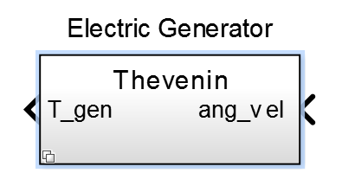
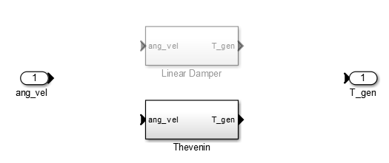
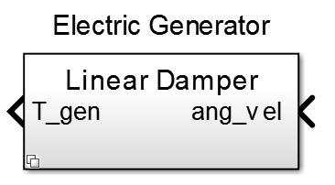
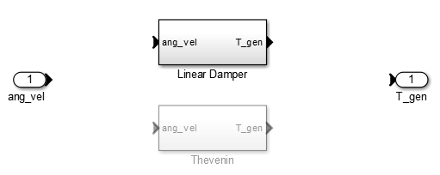
How cool!
Variant Subsystem Level
Inside Variant Subsystem
Just by changing the value of one variable!

Slide 4
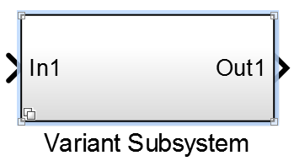
How-To
Step 1: Drag ‘Variant Subsystem’ block into model

Slide 5
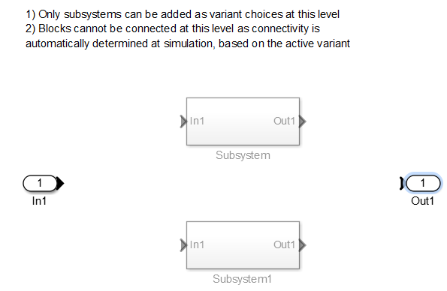
How-To
Step 2: In the Variant Subsytem Create 1 or more regular subsytems that have same I/O (both should be grayed out):

Slide 6
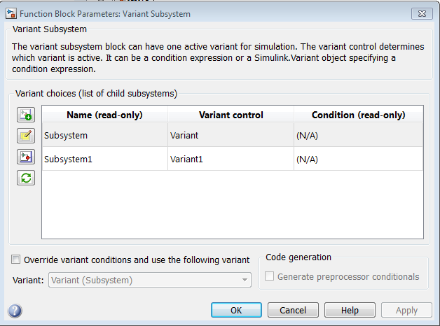
How-To
Step 3: Go back up to the variant subsytem and right-click on it: go to “Block Parameters (Subsytem)”:
“Name” is the name of the regular subsytems and cannot be changed in this block. It can only be changed by modifying the regular subsystem

Slide 7
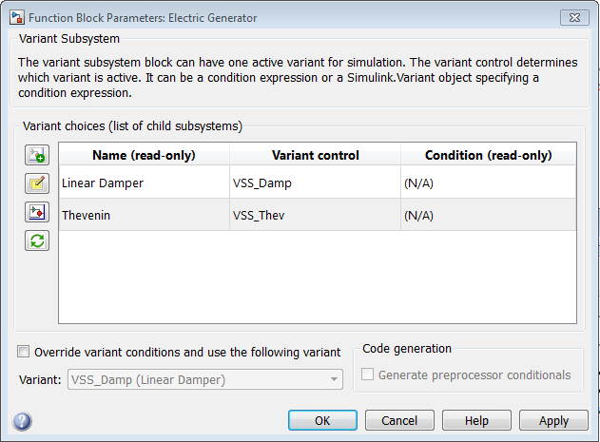
How-To
Step 4: Type in a variable name for the Variant Control for each regular subsystem in the “Block Parameters (Subsytem)”

Slide 8
How-To
Step 5: Give each subsystem a variant control parameter:
In a script or in the workplace write:
“Variant control” =Simulink.Variant(‘variable_name==1');
Using the previous names it would be:
VSS_Damp=Simulink.Variant(‘VSS_Mode==1');
VSS_Thev=Simulink.Variant(‘VSS_Mode==2');
Obviously make sure that your variable name (VSS_Mode) is consistent among subsystems.

Slide 9
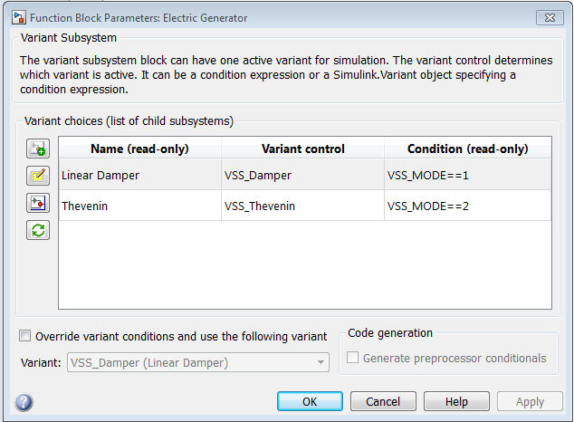
How-To
Step 6: After you run those commands you can check the “Block Parameters (Subsytem)” to see how it updated:

Slide 10
How-To
Step 7: You’re all set!
Just define the value of the variable name before you call the simulink model:
VSS_MODE=2 (calls the Thevenin subsystem in this case)

Slide 11
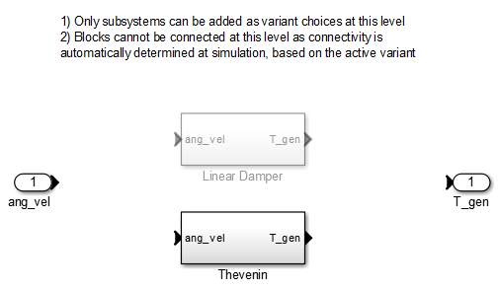
Finish
SIMULINK makes it easy to check that the correct subsystem is activated:
Variant Subsystem Level
Inside Variant Subsystem

